Slide 1
Edge detection

Slide 2
Levels of reasoning in vision
Scenes
Objects
Lines
Edges
Pixels
Images

Slide 3
Levels of reasoning in vision
Scenes
Objects
Lines
Edges
Pixels
Images

Slide 4
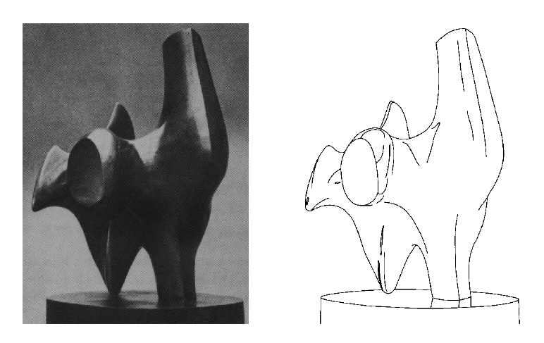
Edge detection
Convert a 2D image into a set of curves
Extracts salient features of the scene
More compact than pixels

Slide 5
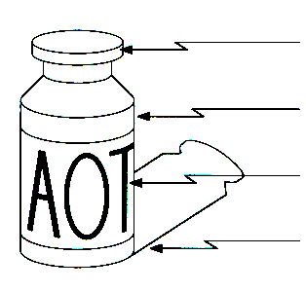
Origin of Edges
surface normal discontinuity
depth discontinuity
surface color discontinuity
illumination discontinuity
Edges are caused by a variety of factors

Slide 6
Edge detection
How can you tell that a pixel is on an edge?

Slide 7
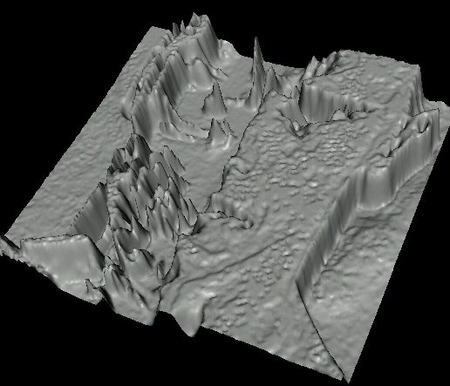

Images as functions…
Edges look like steep cliffs

Slide 8
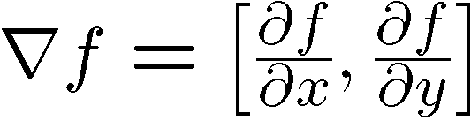
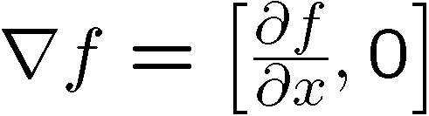

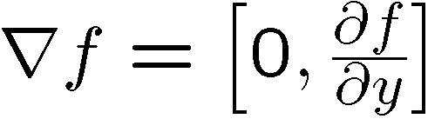
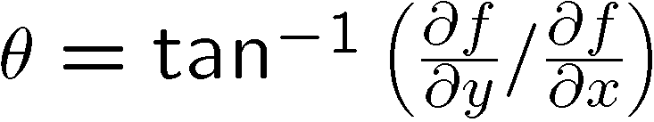
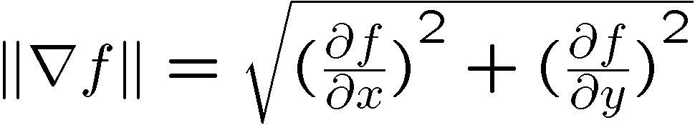
Image gradient
The gradient of an image:
The gradient points in the direction of most rapid increase in intensity
The gradient direction is given by:
how does this relate to the direction of the edge?
The edge strength is given by the gradient magnitude
Notes:
give definition of partial derivative: lim h->0 [f(x+h,y) – f(x,y)]/h

Slide 9
The discrete gradient
How can we differentiate a digital image F[x,y]?
Notes:
Work out on board

Slide 10
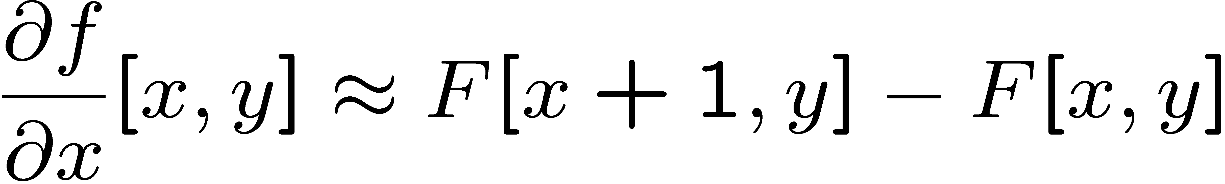

The discrete gradient
How can we differentiate a digital image F[x,y]?
Option 1: reconstruct a continuous image, then take gradient
Option 2: take discrete derivative (“finite difference”)
How would you implement this as a cross-correlation?

Slide 11



The Sobel operator
Better approximations of the derivatives exist
The Sobel operators below are very commonly used
-1 | 0 | 1
-2 | 0 | 2
-1 | 0 | 1
1 | 2 | 1
0 | 0 | 0
-1 | -2 | -1
The standard defn. of the Sobel operator omits the 1/8 term
doesn’t make a difference for edge detection
the 1/8 term is needed to get the right gradient value, however
Notes:
Q: Why might these work better?
A: more stable when there is noise

Slide 12
Comparing Edge Operators
Good Localization
Noise Sensitive
Poor Detection
Gradient:
Roberts (2 x 2):
0 | 1
-1 | 0
1 | 0
0 | -1
Sobel (3 x 3):
-1 | 0 | 1
-1 | 0 | 1
-1 | 0 | 1
1 | 1 | 1
0 | 0 | 0
-1 | -1 | 1
Sobel (5 x 5):
-1 | -2 | 0 | 2 | 1
-2 | -3 | 0 | 3 | 2
-3 | -5 | 0 | 5 | 3
-2 | -3 | 0 | 3 | 2
-1 | -2 | 0 | 2 | 1
1 | 2 | 3 | 2 | 1
2 | 3 | 5 | 3 | 2
0 | 0 | 0 | 0 | 0
-2 | -3 | -5 | -3 | -2
-1 | -2 | -3 | -2 | -1
Poor Localization
Less Noise Sensitive
Good Detection
Notes:
<number>

Slide 13
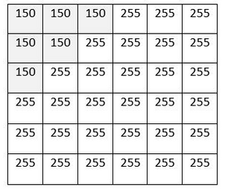
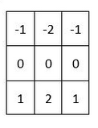
Example problem
Input image
Operator

Slide 14
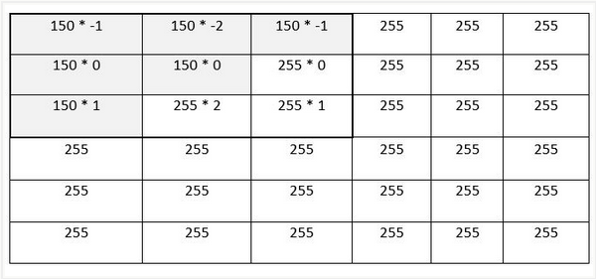
Example problem
Applying filter
Input image
Operator

Slide 15
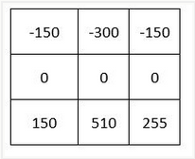
Example problem
Applying filter
Computation
-150 + -300 + -150 + 0 + 0 + 0 + 150 + 510 + 255 = 315

Slide 16
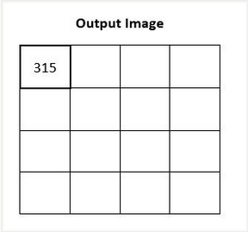
Example problem
Applying filter

Slide 17
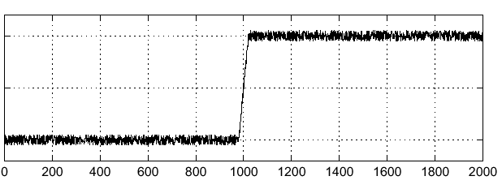

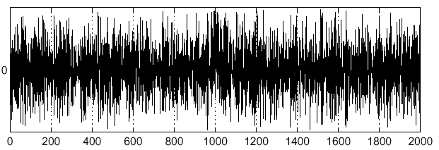
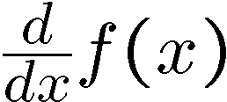
Effects of noise
Consider a single row or column of the image
Plotting intensity as a function of position gives a signal
Derivatives amplify noise!
Where is the edge?
Notes:
How to fix?

Slide 18

Smoothing
Reduce noise by smoothing with a Gaussian

Slide 19
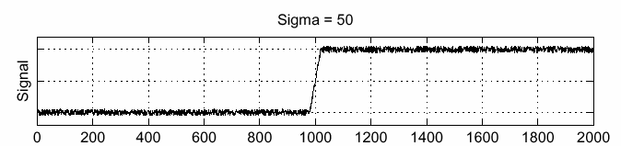

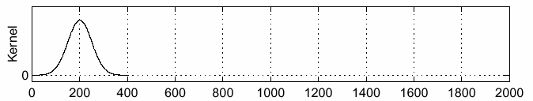

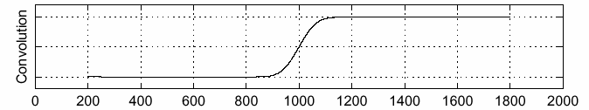

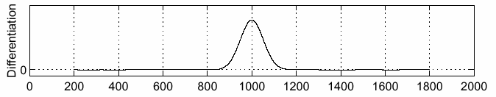
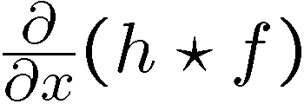
Solution: smooth first
Where is the edge?
Look for peaks in

Slide 20
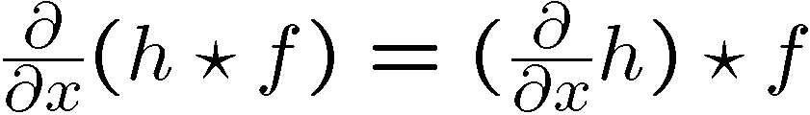
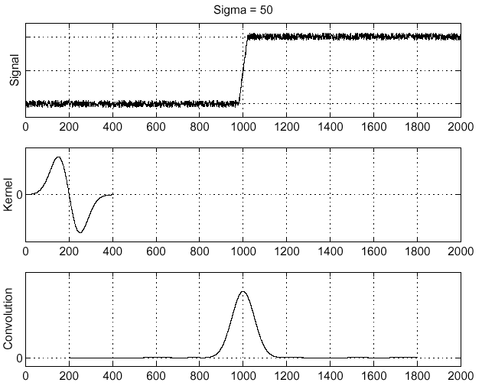
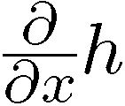
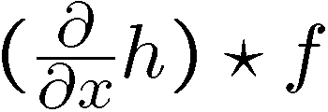
Derivative theorem of convolution
This saves us one operation:
How can we find (local) maxima of a function?

Slide 21
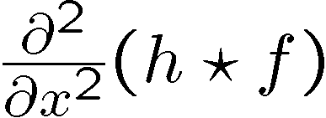
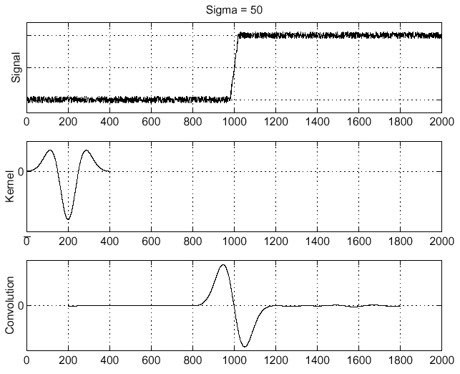
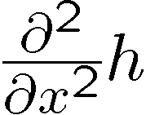
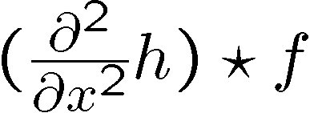
Laplacian of Gaussian
Consider
Laplacian of Gaussian
operator
Where is the edge?
Zero-crossings of bottom graph

Slide 22
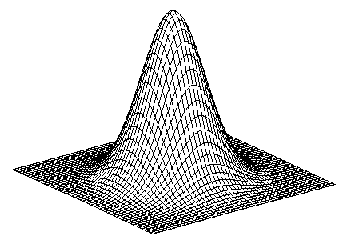
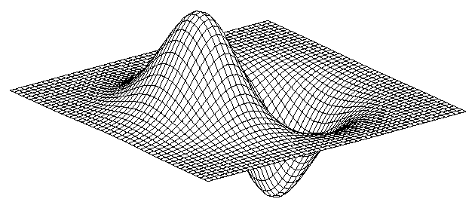
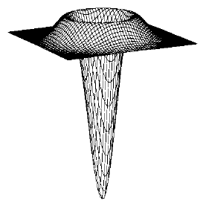
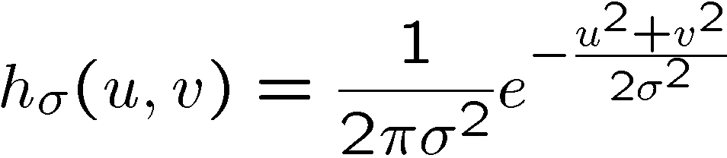
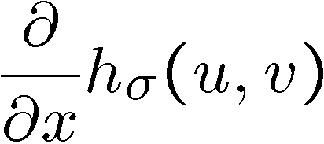
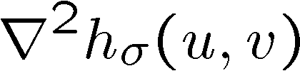

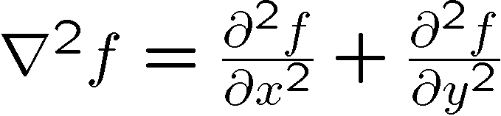
2D edge detection filters
Laplacian of Gaussian
Gaussian
derivative of Gaussian
is the Laplacian operator:
filter demo
Notes:
How many 2nd derivative filters are there? There are four 2nd partial derivative filters.
In practice, it’s handy to define a single 2nd derivative filter—the Laplacian

Slide 23

Edge detection by subtraction
original

Slide 24
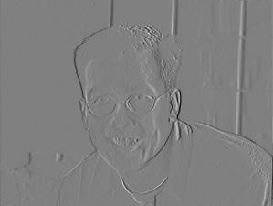
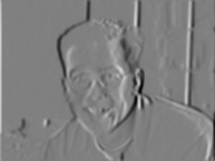
Smoothing
Reduce image noise by smoothing with a Gaussian

Slide 25
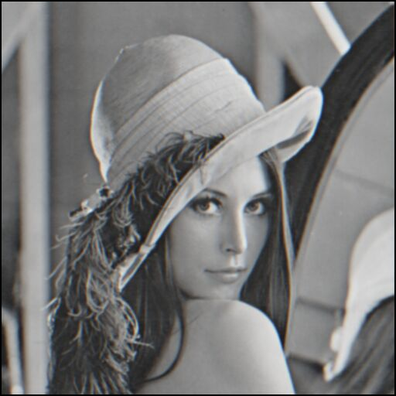
Edge detection by subtraction
smoothed (5x5 Gaussian)

Slide 26
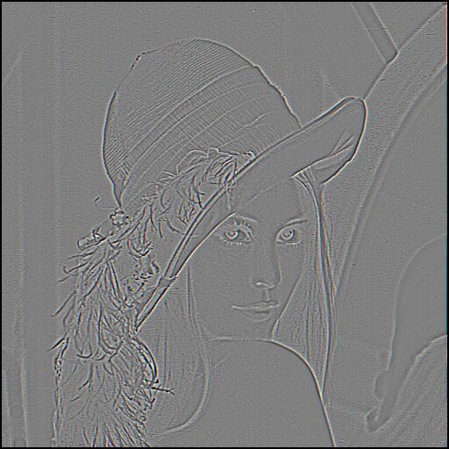
Edge detection by subtraction
Why does
this work?
smoothed – original
(scaled by 4, offset +128)
filter demo

Slide 27

Gaussian - image filter
Gaussian
delta function
Laplacian of Gaussian

Slide 28
Demo
http://shd101wyy.github.io/edge-detection/

Slide 29
Canny Edge Operator
Smooth image I with 2D Gaussian:
Find local edge normal directions for each pixel
Compute edge magnitudes
Locate edges by finding zero-crossings along the edge normal directions (non-maximum suppression)
$G∗I$
$\bar{n}=\frac{∇\left(G∗I\right)}{\left|∇\left(G∗I\right)\right|}$
$\left|∇\left(G∗I\right)\right|$
$\frac{∂^{2}\left(G∗I\right)}{∂{\bar{n}}^{2}}=0$
Notes:
<number>

Slide 30

Non-maximum suppression
Check if pixel is local maximum along gradient direction
requires checking interpolated pixels p and r

Slide 31

The Canny edge detector
original image (Lena)

Slide 32
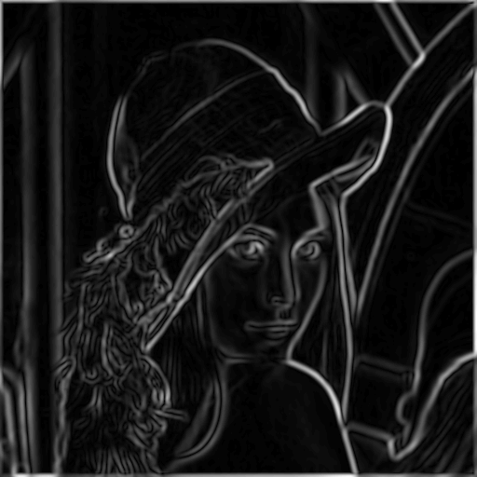
The Canny edge detector
norm of the gradient

Slide 33
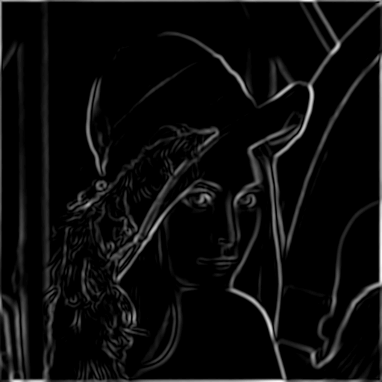
The Canny edge detector
thresholding

Slide 34
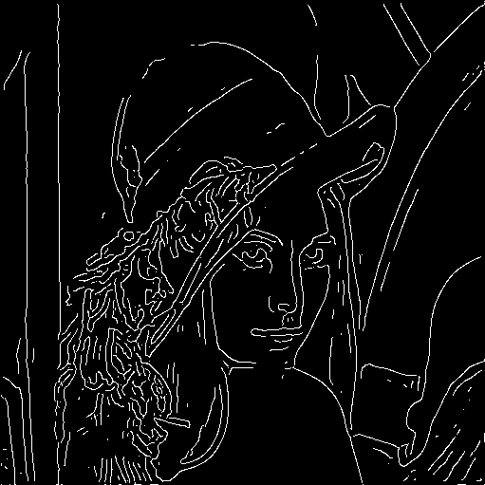
The Canny edge detector
thinning
(non-maximum suppression)

Slide 35

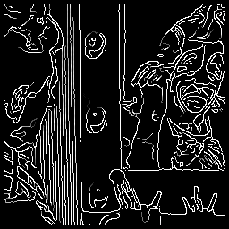
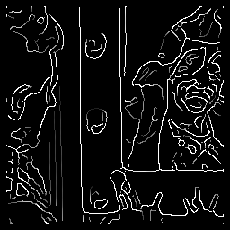



Effect of σ (Gaussian kernel spread/size)
original
Canny with
Canny with
The choice of depends on desired behavior
large detects large scale edges
small detects fine features

Slide 36
Web Demo on Canny Edge Detection
http://matlabserver.cs.rug.nl/cannyedgedetectionweb/web/index.html

Slide 37
Next lecture: sampling
Check if pixel is local maximum along gradient direction
How do we get interpolated pixels p and r?

